Slide 1


MENTAL HEALTH ASSESSMENT:
COURSE TITLE -
AI and ML Fundamentals With Cloud Computing and Gen AI
Presented By:
JEEVANAND A – au810021114032
Guided By:
Mr. P. RAJA, Master Trainer
Dr. V. C. SATHISH GANDHI , Assistant Professor

Slide 2
OUTLINE
Problem Statement
Proposed System/Solution
Algorithm & Deployment
GitHub Link
Project Demo(photos / videos)
Conclusion
Future Scope
References

Slide 3
Problem Statement
Mental Health Assessment:
Facial expression recognition can be used to assess patients' emotional
states and monitor their mental health conditions, enabling early
detection of mood disorders such as depression and anxiety.

Slide 4
Proposed Solution
Facial expression recognition can assess mental health by analyzing emotional states, enabling early detection of mood disorders like depression and anxiety. Using machine learning, it identifies patterns over time, integrates with clinical tools for continuous monitoring, and provides insights for timely intervention while prioritizing privacy and ethical considerations.

Slide 5
Algorithm & Deployment
A mental health assessment algorithm uses questionnaires, natural language processing, and machine learning to analyze users' self-reported symptoms and behavioral data. Key metrics identify mental health risks, and feedback is personalized. For deployment, it integrates with a secure cloud platform, ensuring data privacy, and is accessible via a user-friendly app interface

Slide 6
GitHub Link
http://https://github.com/Jeevanand32/Mental_Health_Assessment-Jeevanand_au810021114032

Slide 7
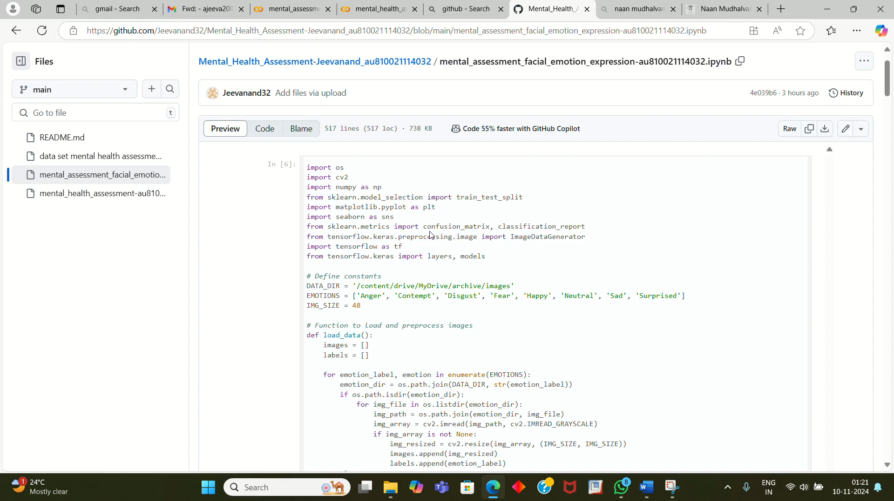
Project Demo(Recorded Video)
Screen Recording of the project done

Slide 8
Conclusion
In conclusion, our mental health assessment model leverages machine learning to identify indicators of mental health conditions based on structured survey and demographic data. By using techniques like data preprocessing, feature selection, and model evaluation, we created a tool that can assist healthcare professionals in identifying potential mental health risks.

Slide 9
Future Scope
For future work on mental health assessment using AI and ML, there are several promising directions. Enhancing model accuracy with larger, more diverse datasets could improve robustness across different demographics. Integrating multimodal data—such as text, voice, and facial expression analysis (FER or Facial Expression Recognition)—could provide a more holistic assessment by capturing various behavioral and emotional cues.

Slide 10
References
1 Facial Emotion Recognition Using Transfer Learning in the Deep CNN M. A. H. Akhand
2 Shuvendu Roy 1, Nazmul Siddique 2, Md Abdus Samad Kamal 3, * and Tetsuya Shimamura.
3 Facial Emotion Recognition Using Deep Convolutional Neural Network Pranav E., Suraj Kamal, Satheesh Chandran C, Supriya M.H.
4 Behavioral Modeling for Mental Health using Machine Learning Algorithms M. Srividya & S. Mohanavalli & N. Bhalaji.

Slide 11
THANK YOU

